Slide 1
7 Reasons Why You Need a Content Copywriter for Your Lawn & Landscape Biz

Slide 2
Reason #1– To Save You Time
You can free up valuable time by hiring a content copywriter. No longer do you need to figure out what to write, how long it to should be and how many keywords you need. While you still need to be involved with the process, you don’t have to worry about the nitty-gritty details of effective content marketing.
You can see your return of investment (ROI) in the spike of new readers as well as other measurable analytics the more you post blogs and other marketing content.
Make sure you hire someone who understands the lawn and landscape industry and who isn’t afraid to develop your voice.
Your content writer can help you develop meaningful relationships with your clients and your sales prospects too.

Slide 3
A content writer can save you time by writing blogs, website content and email newsletters for you.
Photo courtesy of negativespace.co

Slide 4
Reason #2 – Get the Word Out About Your Lawn & Landscape Services
For example, if you specialize in landscape design/build, you want to make sure that every marketing piece emphasizes your landscape design/build practices.
You want your brand accurately displayed throughout all of your social media channels.
Include your logo with every post, tweet, and blog.
Ask your content writer to make sure your brand is consistently communicated across all of your content, including blogs, web pages, social media and newsletters.

Slide 5
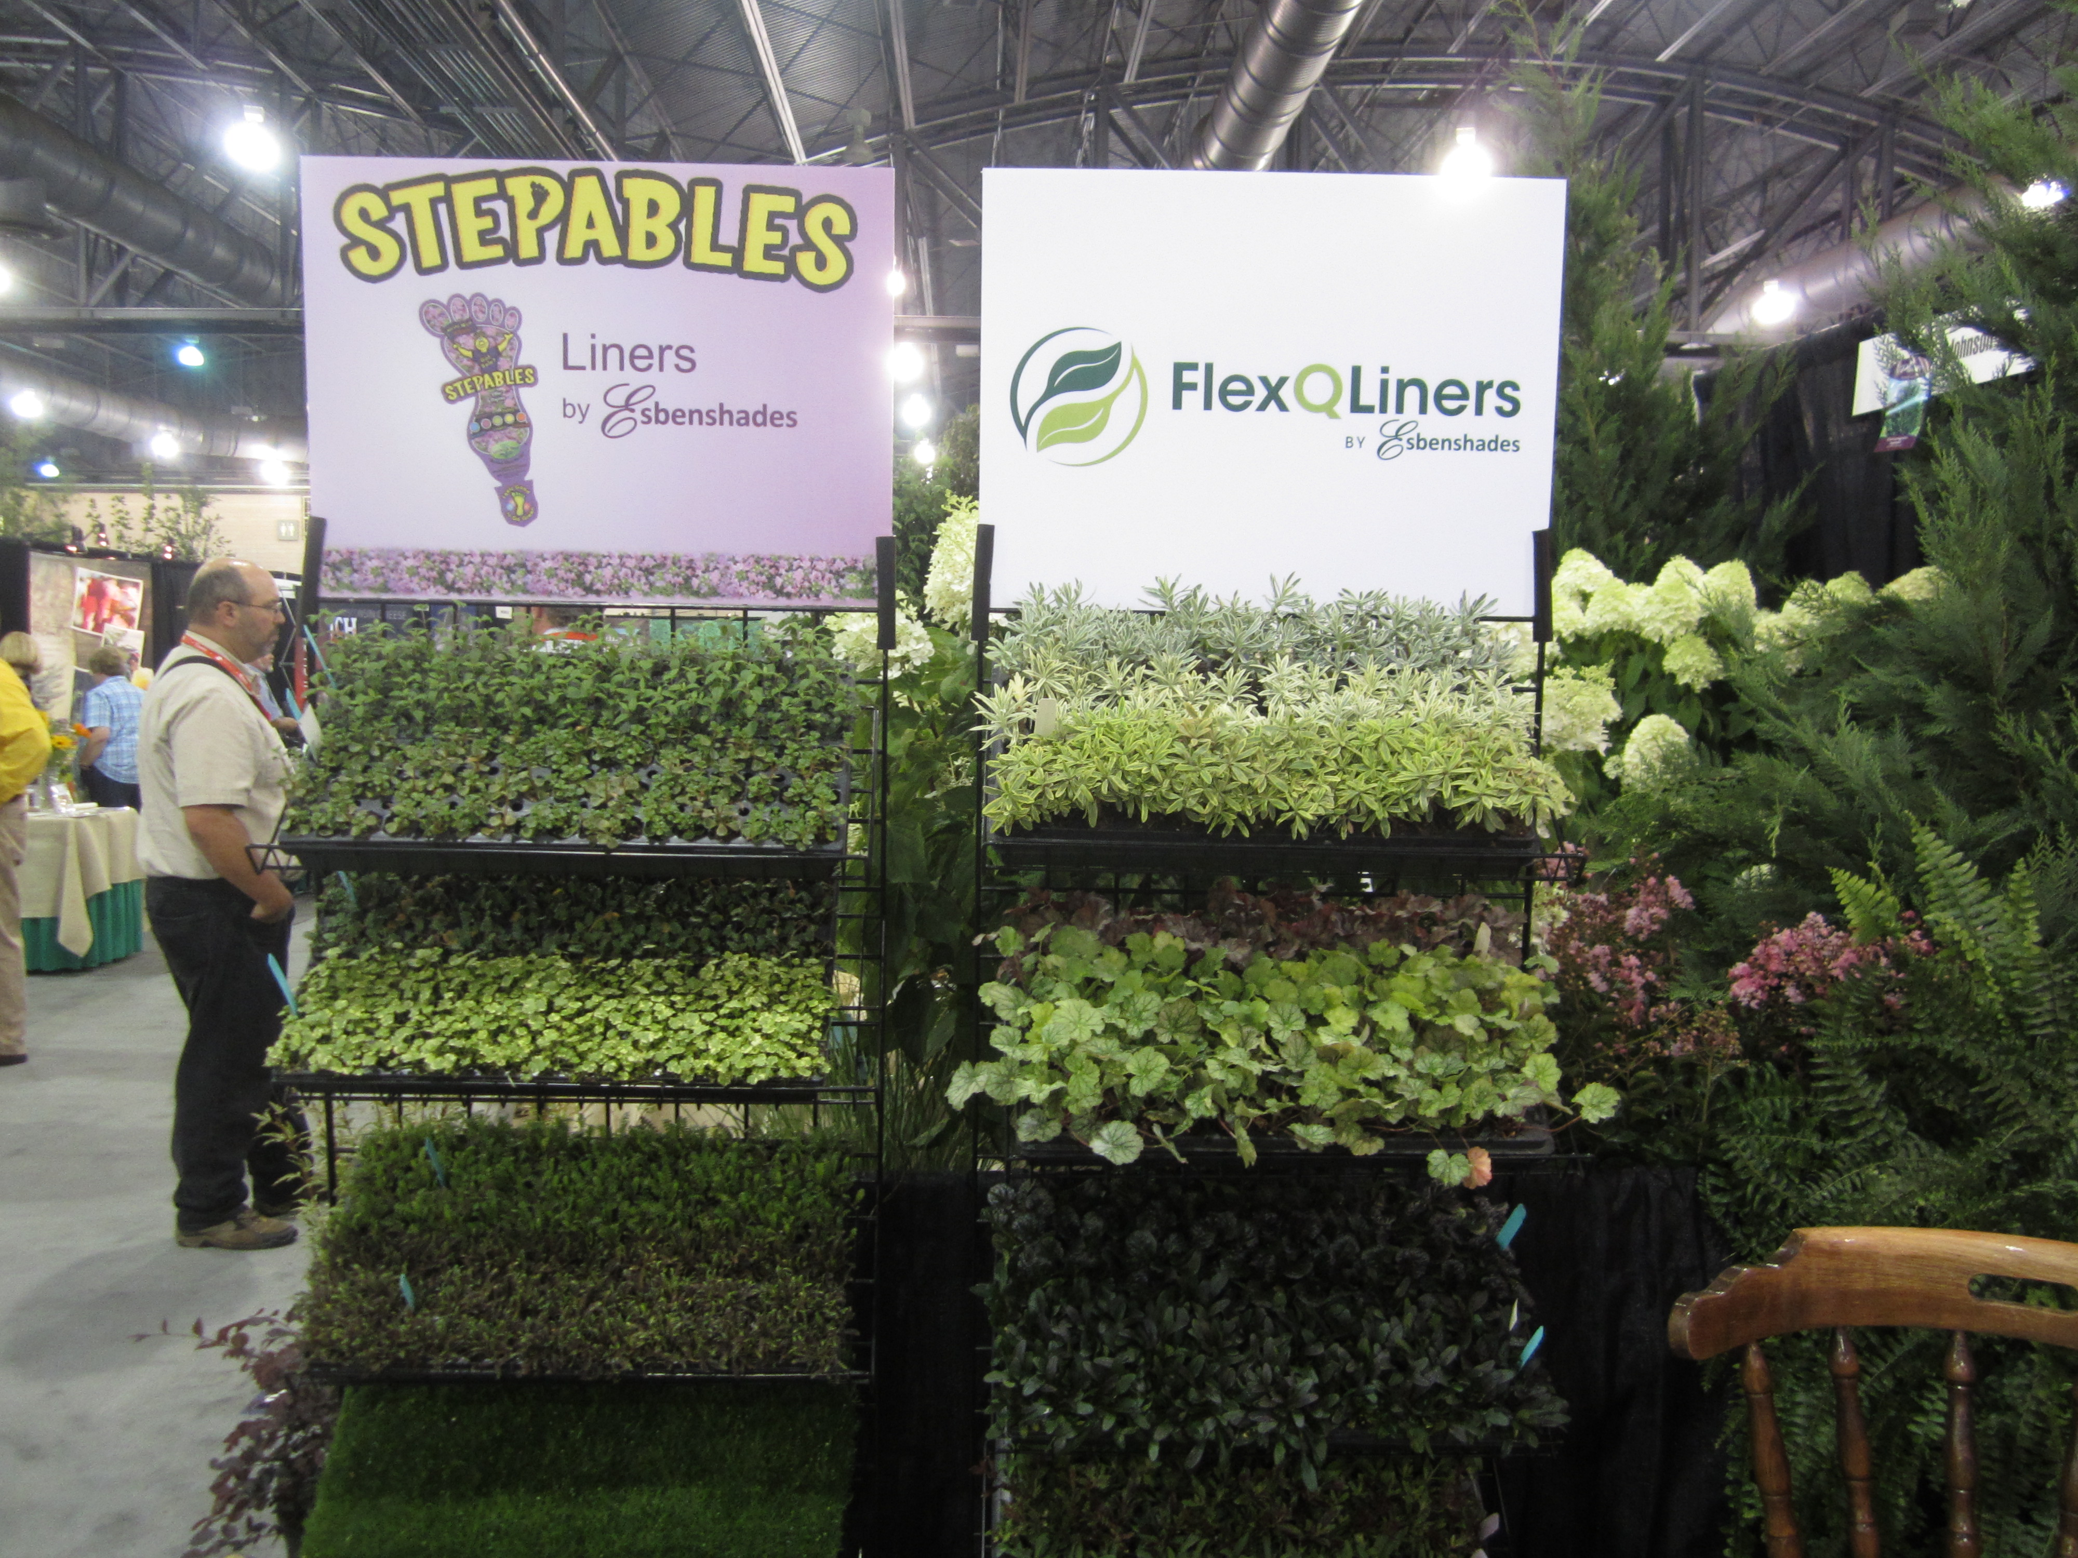

Slide 6
Reason #3 – To add the right keywords at the right place and at the right time.
The days of keyword stuffing are long gone.
Make sure you ask your content writer if she repurposes her content or writes original content for you.
Add hyperlinks back to your services, blogs, and other website content when using keywords, such as lawn care, landscape, decks, and patios.
When you hire a copywriter, you can rest assured that she’ll sprinkle the right amount of keywords at the right place and at the right time.

Slide 7
Reason #4 – Localize, Localize, Localize!
If you want to get more clicks to your website, you need to localize.
You serve a region, multiple cities, etc. within a state or states.
By localizing, your website will show up in more searches when paired with “lawn and landscape,” “decks and patios,” “outdoor kitchens,” “fertilization,” etc.
Use localization to help you reach more sales prospects.
For example, here’s what localization will look like if you’re a lawn and landscape maintenance contractor in Philadelphia, Pa.: “Lawn and Landscape Maintenance in West Chester, the Greater Philadelphia region” OR “Landscape Design for Exton, Kensington Square, and Downingtown, Pa.”
By naming specific cities, townships, counties, etc., you’re alerting search engines to bring your name up in a search for that region.
You know the lawn and landscape issues that your readers have. Add blogs addressing those problems with your solutions
You speak their “language.” You know the area and can speak as “one of us.” Make sure your copywriter inserts your voice into all of your blogs and content.

Slide 8
Get found by localizing your business. A copywriter adds local cities to target your audience

Slide 9
Reason #5 - A Buffet of Content Marketing Communication
Don’t limit yourself to just blogs and good website content.
Expand your marketing to include press releases on company news, email newsletters and social media content to stay in touch with customers.
Fresh content helps your organic search results and brings more people to your virtual door.
A good copywriter will be able to offer you content marketing solutions through a wide variety of channels.

Slide 10
Reason #6 - Teach Me!
Many of your clients want to see tips to maintain their lawn and landscapes in between appointments.
Give them practical advice that they can easily do such as deadheading blossoms or starting a vegetable garden.
Take into consideration what your readers’ gardening level may be. For example, if you serve clients who are retired, you can include some practical gardening tips. Likewise, if your clients are millennials and new homeowners, you might share specific lawn care tips with them.
Avoid a lot of jargon—remember, your clients hire you to take care of the technical stuff. Unless they’re heavy-duty DIY’ers. keep it simple and fun.
Your copywriter can help you by writing tips that match your ideal audience.

Slide 12
Reason #7 – Get Social!
Add pictures—especially of your own work—to your social media message to add to the trust factor.
And to show off your lawn, landscape & hardscape skills.
Remember the reader. Who are your core readers going to be? Women, men? Retired, new homeowners? Facebook users differ from Twitter and Google+. Know who you’re talking to.
Just like you gear your blog to your readers’ interest—so you must tailor your social media messages to reach the right person.
A copywriter can write content for your social media outlets. Again, she knows your voice, your readers’ pain points, and how to communicate your message to reach your audience no matter where they hang out online.

Slide 13
Want to learn more?
Visit the Landscape Writer.
If you’re ready to hand off your writing chores to a seasoned content copywriter, feel free to fill out my online consultation form, email me at wendy@landscapewriter.com or call me at 717-381-6719.
You can Twitter me at @LawnNLandwriter.
Find me on LinkedIn at https://www.linkedin.com/in/wendykomancheck.
Like on Facebook at https://www.facebook.com/Wendy.BizWriter/.

