Slide 1
5 Blog Topics to Tackle
Ideas to Make the Most of Your Lawn & Landscape Content Marketing in 2016

Slide 2
True or False: Before you start a blog, you need to know what your reader needs and wants.
True
You need to know what your readers’ pain points are. What lawn care and landscape problems are they dealing with? How many of them are hands-on versus hands-off? How can you save them money and time?

Slide 3
Not sure what your customers’ pain points are?
Garden Media did a survey on what folks are looking for in their landscape/lawn care professional. Their survey can guide you to your customers’ pain points

Slide 4
1. For example, your clients don’t want to pull weeds
The Garden Media Group found in their 2016 Gardening Trends Report that homeowners hate to tend their own flower beds and landscapes.
If your lawn and landscape company provides landscape maintenance services, are you telling your prospects?
Blog about the benefits of mulching, grasscycling, tree pruning and weed control.

Slide 5
2.Gardening is seen as a chore to many homeowners.
In your blogs, take the pain out of gardening by describing how you tend your customers’ trees; add mulch to their landscaped beds and that your crews will weed for them. In your blogs and videos, describe each of your services and its benefits for curb appeal.
At the end of your blog or video, tell your readers that your lawn care and landscape company is the one to call to get these gardening chores done right.

Slide 6
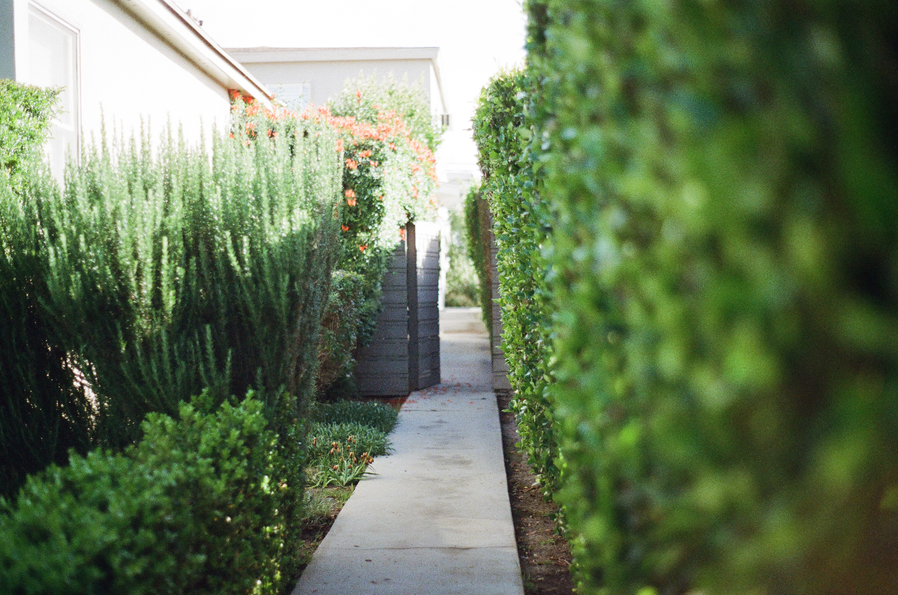

Slide 7
3. Close the generation gap
Don’t discount Millennials (born between 1982 – 2004). They’re now buying homes and starting families. They may need help with mowing, edible landscaping, and organic lawn care. Blog topic: “Why You Need ACME Landscape & Lawn Care to Mow Your Lawn”

Slide 9
4. Outdoor living
If you design and build patios, decks, outdoor kitchens and living rooms, you can take your readers through a tour of your latest and greatest projects. Don’t forget to add lots of pictures to these case study blogs.
Photo courtesy: Texas Custom Patios 2012

Slide 10
5. Living landscapes
Homeowners still want organic products used on their lawns and in their landscapes. The newest trend is dogscaping. The emphasis is on safer lawn care treatments to lower the risk of Fido getting cancer. Write a blog or two about your lawn applications’ safety. What’s the toxicity level? Can Fido go safely out to play in the yard after the lawn treatment dries?

Slide 11
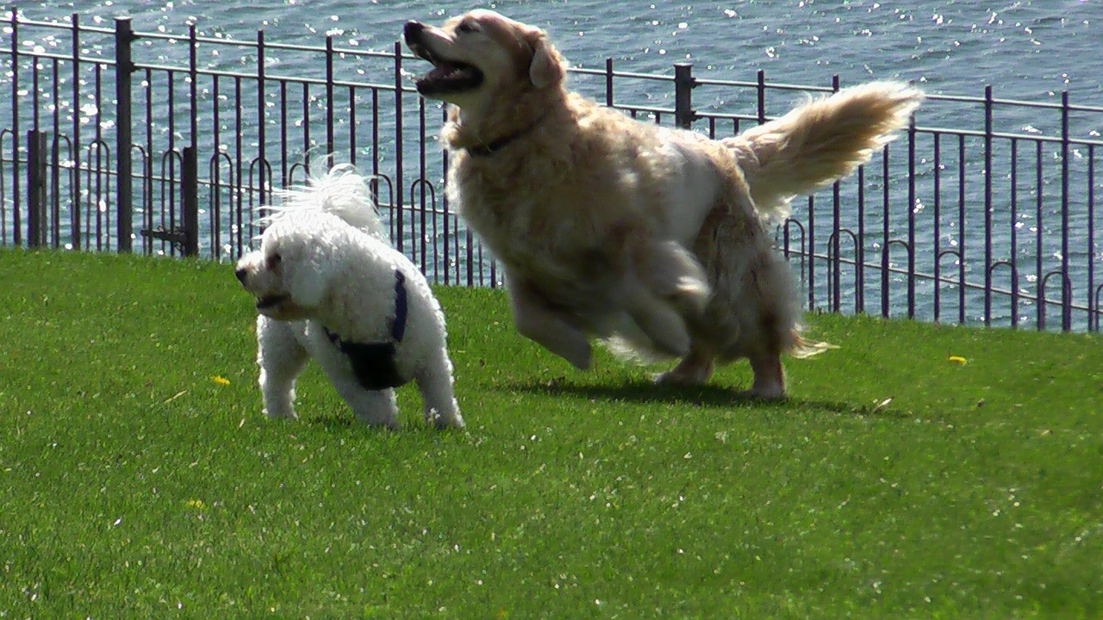

Slide 12
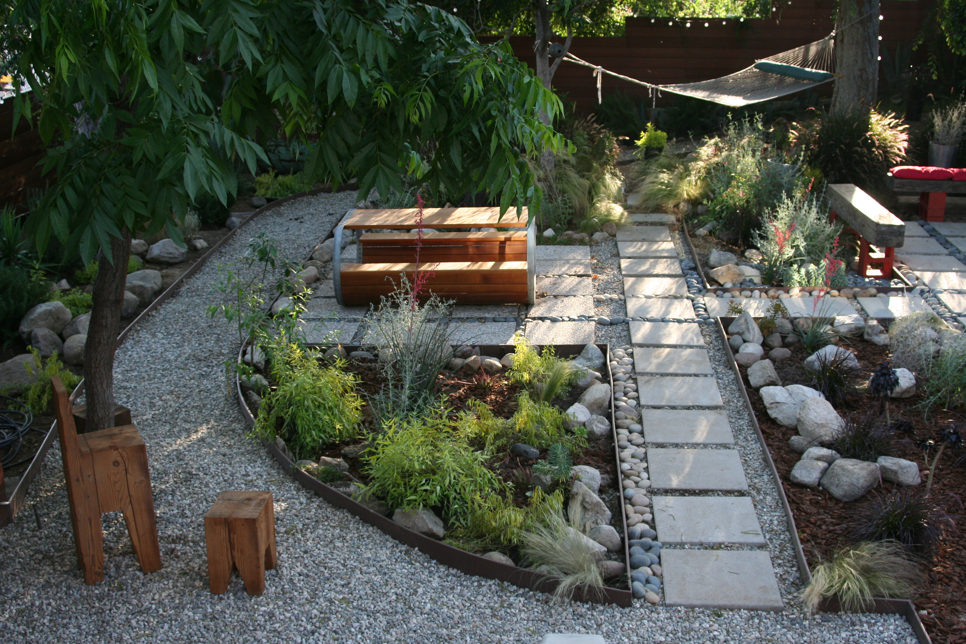
You can also write blogs about layered and sustainable landscaping, two other popular trends for homeowners. Photo courtesy of Jeremy Levine Design, https://www.flickr.com/photos/jeremylevinedesign/

Slide 13
Some final pointers:
Use your content marketing plan to reach more prospects. Turn those prospects into paying customers using the following ideas:

Slide 14
Boomers love their technology as much as Millennials & Gen Xers

Slide 15
Use social media and other forms of content marketing to reach Boomers, Gen Xers & Millennials
Keep in touch with your clients and prospects through e-blasts, e-newsletters, blogs, videos and podcasts.
Stay on top of your social media plan.
If you need help with your content marketing, hire a content writer, a web designer, and a social media consultant to help you get started.

Slide 16
Want to learn more?
Contact The Landscape Writer at 717-381-6719 or email at wendy@landscapewriter.com.

